Slide 1
IBM Advance Data Science Capstone Project: Predicting Sales Outcome
Reetu Singh

Slide 2
Index
A presentation targeted at stakeholders
The data set
The use case
The solution to the use case

Slide 3
Data Set
Data set consist of Sales data.
Contains a list of the opportunities /prospect of any given quarter.
Data attributes: Opportunity total Age, age since in sales stage1 to sales stage 5, Roll over count (from one quarter to another) etc.
Each opportunity is tracked since the date when they were first entered and passed on from one sales stages to another i.e their life history. Sales stages are the business defined stages and decided by the process model.
They are also tracked for number of times they have been rolled before they were either won/lost.

Slide 4
Use Case
Every business is dependent upon a list of opportunity/Deals they create in a given quarter, How much should they add new opportunity and when.
Sales leader wants to know which opportunity might loose/win and/or roll over to the next quarter in advance.
Based on this, sales leader revise their business plan for maximum success.
Since sales leaders have fixed target to accomplice, the predicted roll overs allows them to approximate the new opportunity they will need to add for the future quarters.
This predicted outcome helps sales leader to control the success of their business results.

Slide 5
Solutions
Refer to the Notebook on IBM Watson Studio.
Predicting_Sales_Outcome_ModelDeployment :
https://dataplatform.cloud.ibm.com/analytics/notebooks/v2/a2cbbe57-89fd-417b-a099-d48ce17b20d8/view?access_token=36bc7b450f9a931cc179898c38f0bcaedf5125fd253523d9f2ec92840ee1f447

Slide 6
Index
A presentation targeted at data science peers:
Architectural choices
Data quality assessment, data pre-processing and feature engineering
Model performance indicators
Model algorithm

Slide 7
Architectural Choice
The data is stored on the IBM Watson studio Cloud Object Store.
This project is developed on the IBM Watson studio with Jupyter Notebook.
Used Python scripting languages with data science libraries such as numpy, pandas, seaborn, scikit-learn and keras.
IBM Watson Cloud with Jupyter Notebook, copy available on GitHub as well.

Slide 8
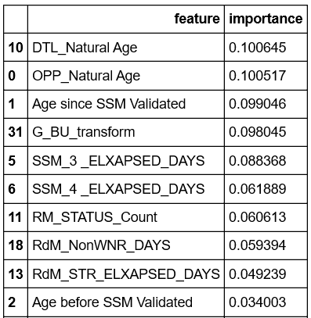
Data assessment, Quality, Feature Engineering 1/4
Data attributes:
We have 32 data fields and 80K observation for training set.
It comes with a predefined training and testing set indicated in column ‘Partition’.
The most important features for are Opportunity Age, age in sales stages (sales stages are business defined and varies from 1 to 5), Roll over count (moving from one quarter to another) , Opportunity age since detail updated etc.
Data Quality assessment
Current data is mostly clean except Imbalanced classes and missing data (1% of the total dataset).
Data has no duplicates, no empty row or column
Feature Engineering:
There are 8 field that have 1740 entries each as null values. Given that it makes only 1% of the total dataset and as per our business understanding imputing such data does not add any value, hence we would filter it out.
Data attributes list:
OPP_Natural Age, Age since SSM Validated, Age before SSM Validated, SSM_1 _ELAPSED_DAYS, SSM_2 _ELAPSED_DAYS, SSM_3 _ELAPSED_DAYS, SSM_4 _ELAPSED_DAYS , SSM_5 _ELAPSED_DAYS, OPP_Backward count, OPP_Forward count, DTL_Natural Age, RM_STATUS_Count , RM_NIR_ELAPSED_DAYS, RM_STR_ELAPSED_DAYS, RM_KEY_ELAPSED_DAYS, RM_ATR_ELAPSED_DAYS, RM_SOL_ELAPSED_DAYS, RM_WSR_DAYS, RM_NonWSR_DAYS, RM_Forward count, RM backward count, Forward quarter_count, Backward quarter_count, Roller_Flag_NUM, Chronic_Roller_Flag, Not_Roller_Flag, Same_Quarter_Updater_Flag, Deal_Accelerator_Flag, One_Time_Roller_Flag, Record_Count, AGE_FLAG, OUTCOME, G_BU_transform.

Slide 9
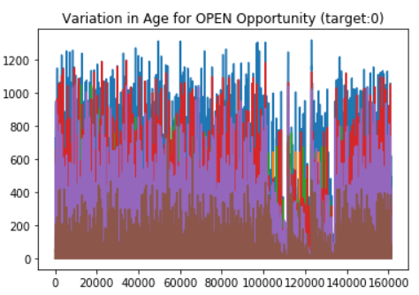
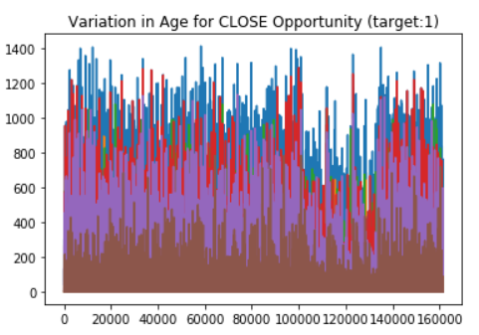
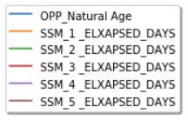
Data assessment, Quality, Feature Engineering 2/4
Age when outcome/target variable = 0
Age when outcome/target variable = 1
Data Visualization
: The most important features are Opportunity total Age, age in each sales stage (sales stages are business defined and varies from 1 to 5).

Slide 10
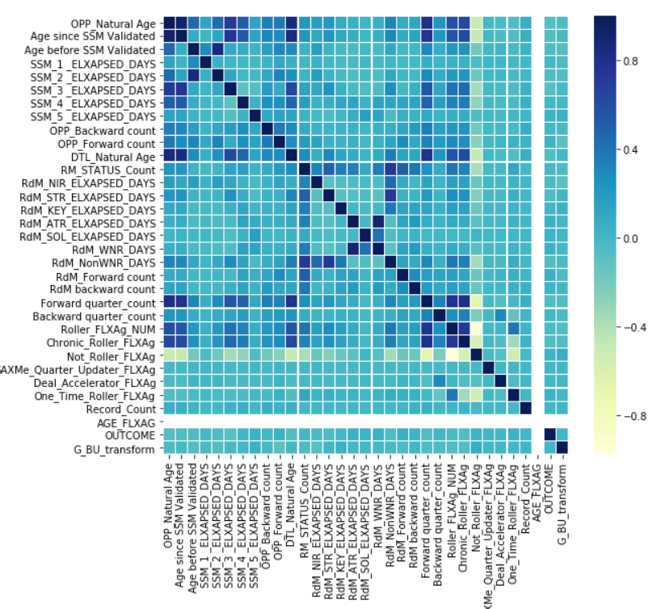
Data assessment, Quality, Feature Engineering 3/4
Data Exploration :
As can be seen here high correlation Variables are Opp natural age, Age since SSM Validated, Elapsed days (2), RdM wnr days, roller flaxg num, chronic roller num, dtl natural age, forward qtr count.

Slide 11
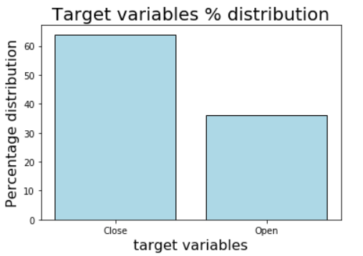
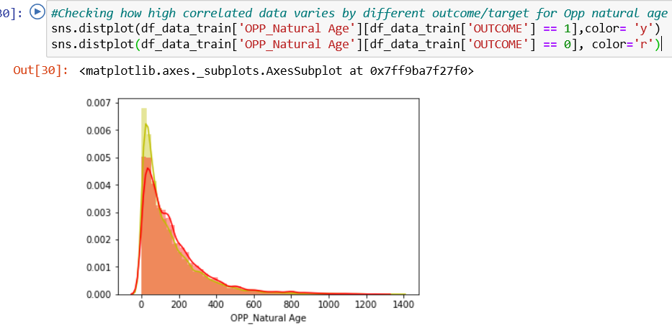
Data assessment, Quality, Feature Engineering 4/4
#Data is imbalanced. As there are 36% rows with '0' outcome and 64% rows with '1' outcome. #This is expected as '1' indicates those opportunities which were either won or lost. # In any quarter data with '1' outcome would be more than '0’. However, later in during the modelling, we shall make the data balance to see if it improved the performance.
In this graph, we see a density plot with y axis is in terms of density and x-axis is Age of the opportunity. Close ‘1’ is ‘Yellow’ in color showing high density and Open ‘0’ in ‘red’ color showing low density.

Slide 12
Model Performance Indicator
Since we are dealing with bi-classification Supervised data set, Models' performance assessment methods used are:
Confusion matrix
Precision
Recall
F1-score
Accuracy
ROC AUC

Slide 13
Model Algorithm 1/5
In this project, we are dealing with Supervised data set, i.e we are dealing with bi-classification problem where target variable is ‘0’ and ‘1’.
For the sales data, ‘1’ outcome means the deal is close (i/e either won or lost) and ‘0’ outcome means deal is still open(i.e Rolled over/ moved to the next quarter).
In this project, I have explored several of models:
Support Vector Machine
Support Vector Machine with PCA
Naïve Bayes,
Random forest,
CNN

Slide 14


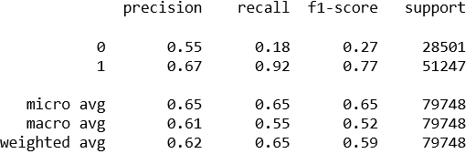
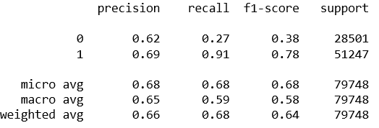
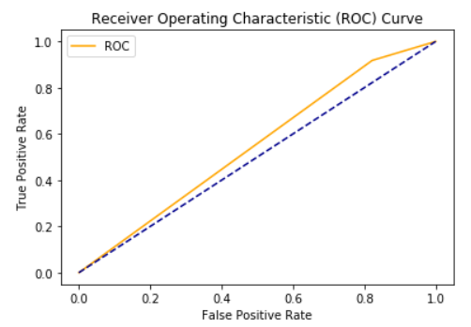
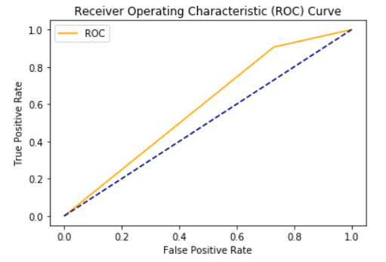
Model Algorithm 2/5
Support Vector Machine:
Time taken to execute: 35 min
Accuracy: 63%,
Confusion Matrix:
Classification Report:
AUC: 0.55
Support Vector Machine with PCA:
Time taken to execute: 20 min
Accuracy: 68%,
Confusion Matrix:
Classification Report:
AUC: 0.59

Slide 15


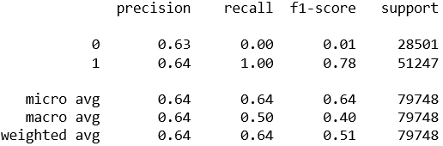
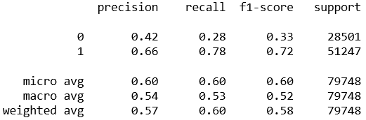
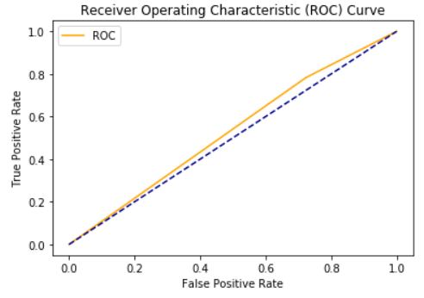
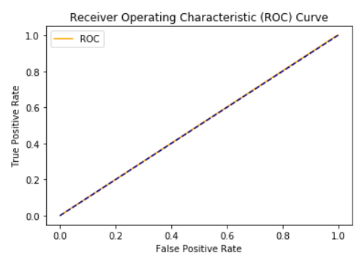
Model Algorithm 3/5
Naïve Bayes :
Time taken to execute: 2 min
Accuracy: 60%,
Confusion Matrix:
Classification Report:
AUC: 0.53
Convolution Neural Network:
Time taken to execute: 10 min
Accuracy: 64%,
Confusion Matrix:
Classification Report:
AUC: 0.50

Slide 16


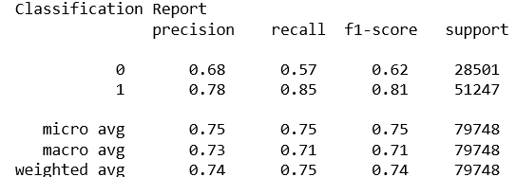
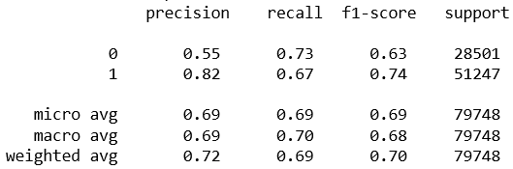
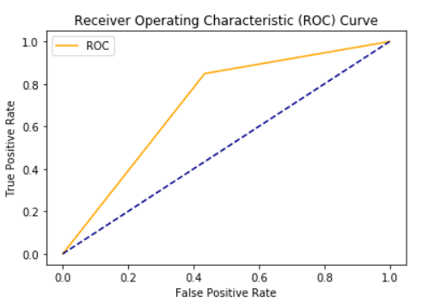
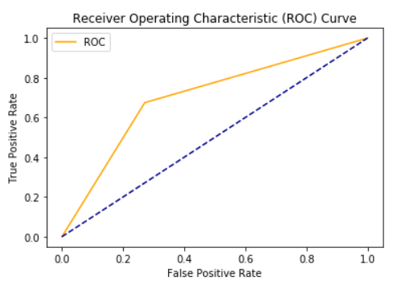
Model Algorithm 4/5
Random Forest Classification:
Time taken to execute: 5 mins
Accuracy: 75%,
Confusion Matrix:
Classification Report:
AUC: 0.71
Random Forest Classification after training Data Balancing:
Time taken to execute: : 5 mins
Accuracy: 69%,
Confusion Matrix:
Classification Report:
AUC: 0.70

Slide 17
Model Algorithm 5/5
Notebooks are saved here and also uploaded on GitHub (https://github.ibm.com/reetusin/IBM-Advance-DS-Capstone-project)
Predicting_Sales_Outcome_Data_Exp : https://dataplatform.cloud.ibm.com/analytics/notebooks/v2/98d26b55-ea1c-4c59-810c-2bed876add26/view?access_token=a72a6f10043b95859dfd07abc0c282cc6039bfc01270ecd6d56dc12161af1c2f
Predicting_Sales_Outcome_ETL: https://dataplatform.cloud.ibm.com/analytics/notebooks/v2/02dd4658-b001-4258-ac9a-e35afff5229e/view?access_token=c0d4c5b5bc297e00ad7cfc8a11c5c1427a04404442bb38b916d67bf195eda1f4
Predicting_Sales_Outcome_Feature_eng : https://dataplatform.cloud.ibm.com/analytics/notebooks/v2/f93dbfdb-6499-4d0b-ab21-c5b8a3bee322/view?access_token=6a27b6c2efe787436c64dbc1efa5c0a924aa51f096c0b38923777ff10d8db973
Predicting_Sales_Outcome_Model_def : https://dataplatform.cloud.ibm.com/analytics/notebooks/v2/ec672a6c-c3de-4da0-93ae-42c35f53ca54/view?access_token=1d3f5d9e3094356f26a7e5283a8b72143ba8739f756ecfc37eb097127aa79aea
Predicting_Sales_Outcome_Modelling : https://dataplatform.cloud.ibm.com/analytics/notebooks/v2/87021c5b-7ad2-4e96-9b18-dda6484e0088/view?access_token=461c0f6b1be5881ddebedc33cdcfaa86c06846e2f4aa852123edf61b19100e1f
Predicting_Sales_Outcome_ModelDeployment :
https://dataplatform.cloud.ibm.com/analytics/notebooks/v2/a2cbbe57-89fd-417b-a099-d48ce17b20d8/view?access_token=36bc7b450f9a931cc179898c38f0bcaedf5125fd253523d9f2ec92840ee1f447

Slide 18
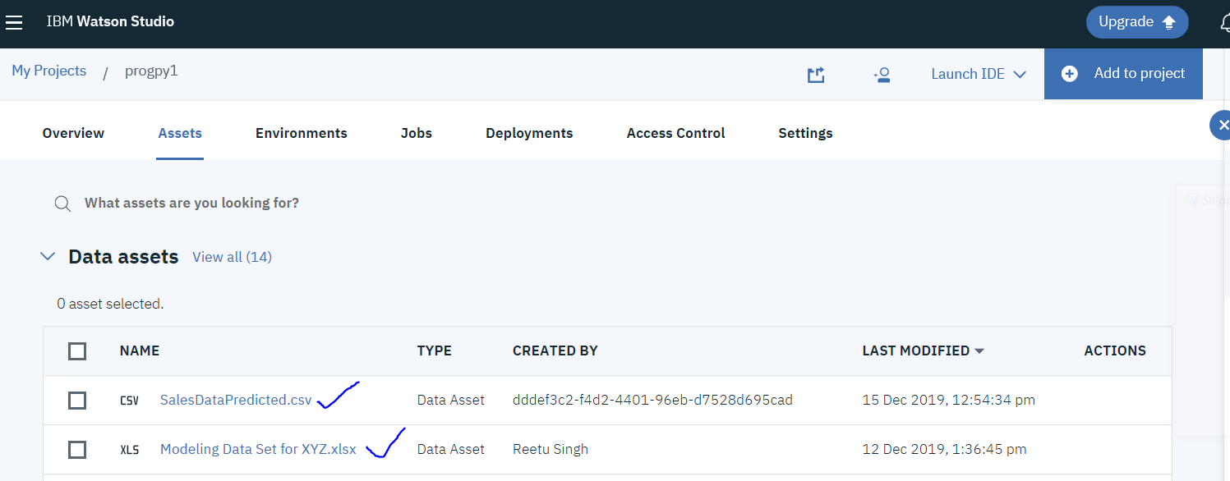
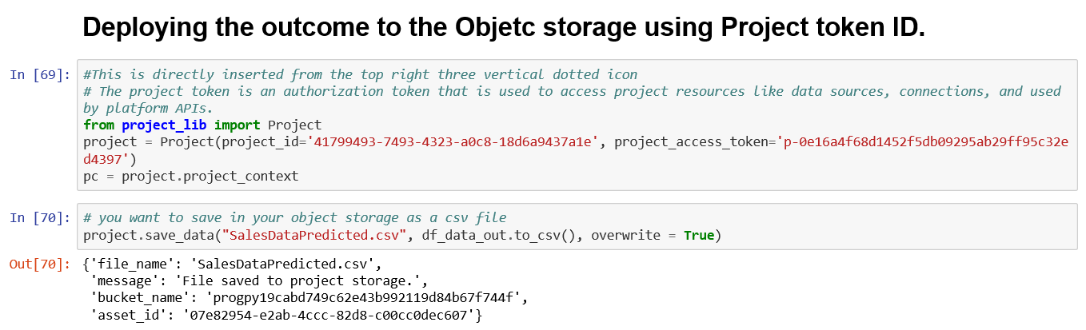
Model Deployment

Slide 19
THE END

